Slide 1
Group 3
Software Architecture & Design

Slide 2
Members
Nguyễn Đình Thông
Nguyễn Thị Thái Hân
Nguyễn Văn Hùng
Đặng Mạnh Hùng
Tường Đức Khang
Vũ Thanh Hải

Slide 3
Main content
Introduce
Environment
Function
Setting

Slide 4
Introduce
Mobile phone sales system website
Management of customer information
Provide customers with the latest product updates and pricing
Statistics, reports, accurate numbers of products and guests

Slide 5
Environment
Software development tools
-Visual Studio 2013
-SQL Server 2012

Slide 6
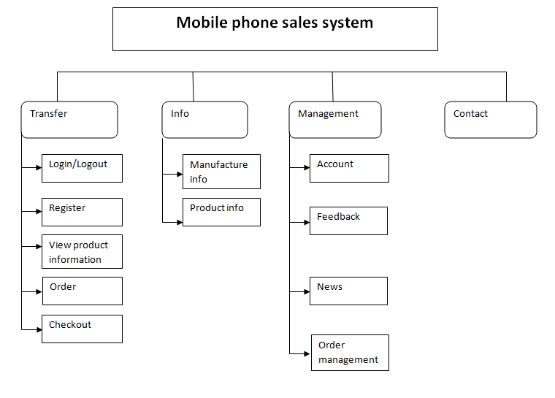
Function

Slide 7
Setting
Hardware requirements : Minimum hardware configuration Intel Celeron 1.4GHz, RAM 256MB, system WinXP.
Database requirements: SQL server 2005

